Slide 1

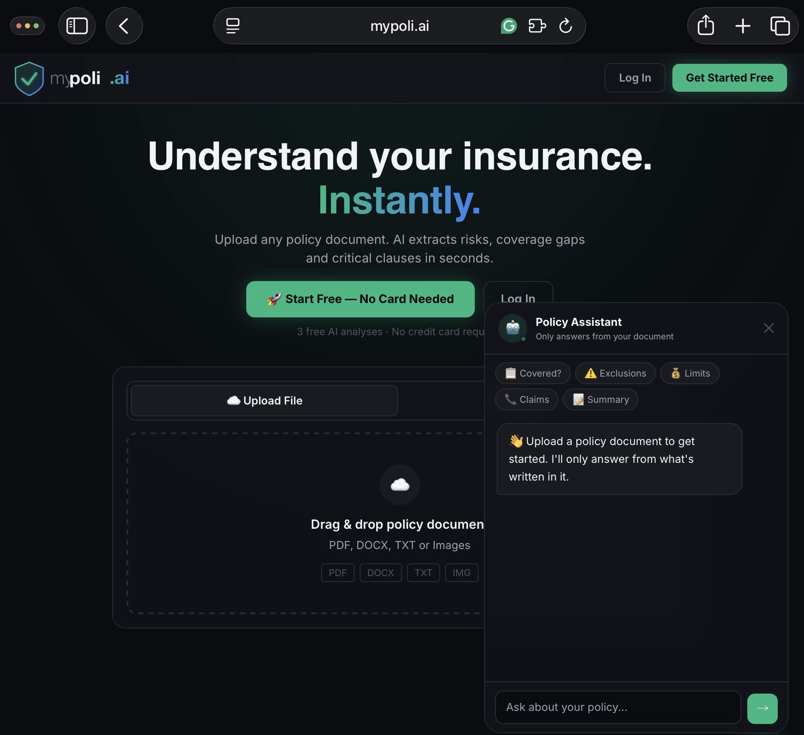
mypoli.ai
The intelligent home for all your insurance.
Investor Presentation · 2026
Confidential · hello@mypoli.ai · mypoli.ai

Slide 2
01 — THE PROBLEM
People are flying blind
on their insurance.
73%
68%
€2.1B
"I tried to claim on a broken window in my rental property. I had no idea what was covered. I spent hours trying to get someone on the phone just to get a straight answer."
of policyholders
never read their policy
don't know what
they're NOT covered for
lost to unclaimed
valid policies annually
Three burning problems:
— Shane Duffy, Founder
Rejected claims — exposed at the worst moment
Overpaying — overlapping cover, wasted money
Inertia — too confused to compare or switch

Slide 3
02 — THE PRODUCT
Built in four layers.
AI is the engine. Clarity is the product.
🗂️
🧠
⚡
🌐
Layer 01
Layer 02
Layer 03
Layer 04
System of Record
Intelligence
Action
Ecosystem
Upload and manage all your insurance policies in one place.
→
Understand your true coverage, risk exposure, and gaps.
→
Get recommendations, renewals, claims guidance, and support.
→
Enable brokers and insurers to deliver proactive, personalised experiences.
Home · Life · Car · Health · Business · Travel — every policy, every insurer, one dashboard. Always up to date.
AI analyses every policy. Coverage Score 0–100. Underinsurance alerts. Gap identification against your life profile.
Switch to better cover. File a claim. Get renewal reminders. One-click actions — not just information.
White-label portal. Marketplace engine. Enterprise API. Broker admin. Gap-to-product matching at scale.

Slide 4
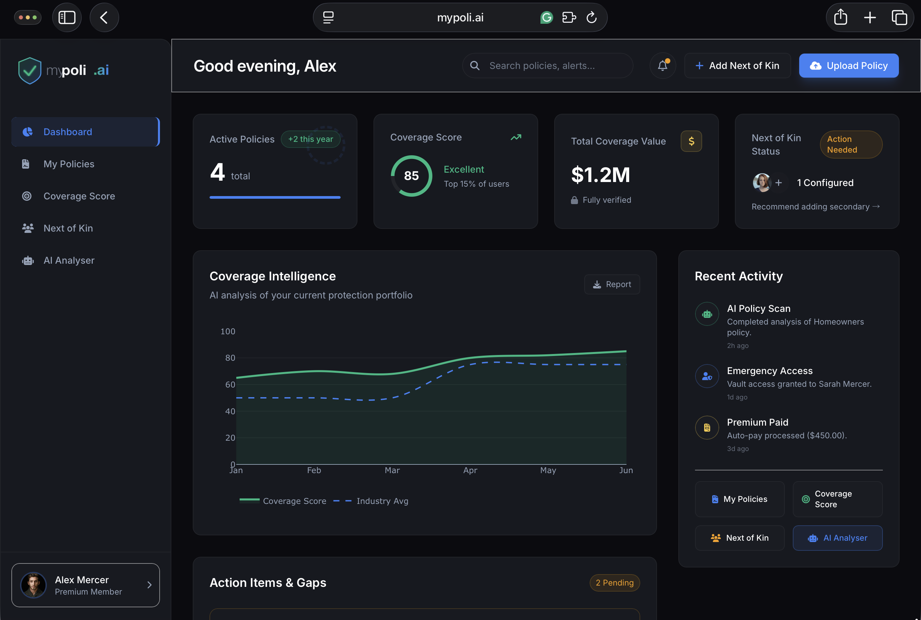
LAYER 01 — SYSTEM OF RECORD
Everything in one place.
Most people have 4–6 policies across different insurers, different renewal dates, and documents buried in email folders or kitchen drawers.
MyPoli.ai is the single place where all of it lives.
🏠 Home
❤️ Life
🚗 Car
🏥 Health
💼 Business
✈️ Travel
One renewal dashboard.
One coverage view.
One place your family can find everything.
Replace with screenshot

Slide 5
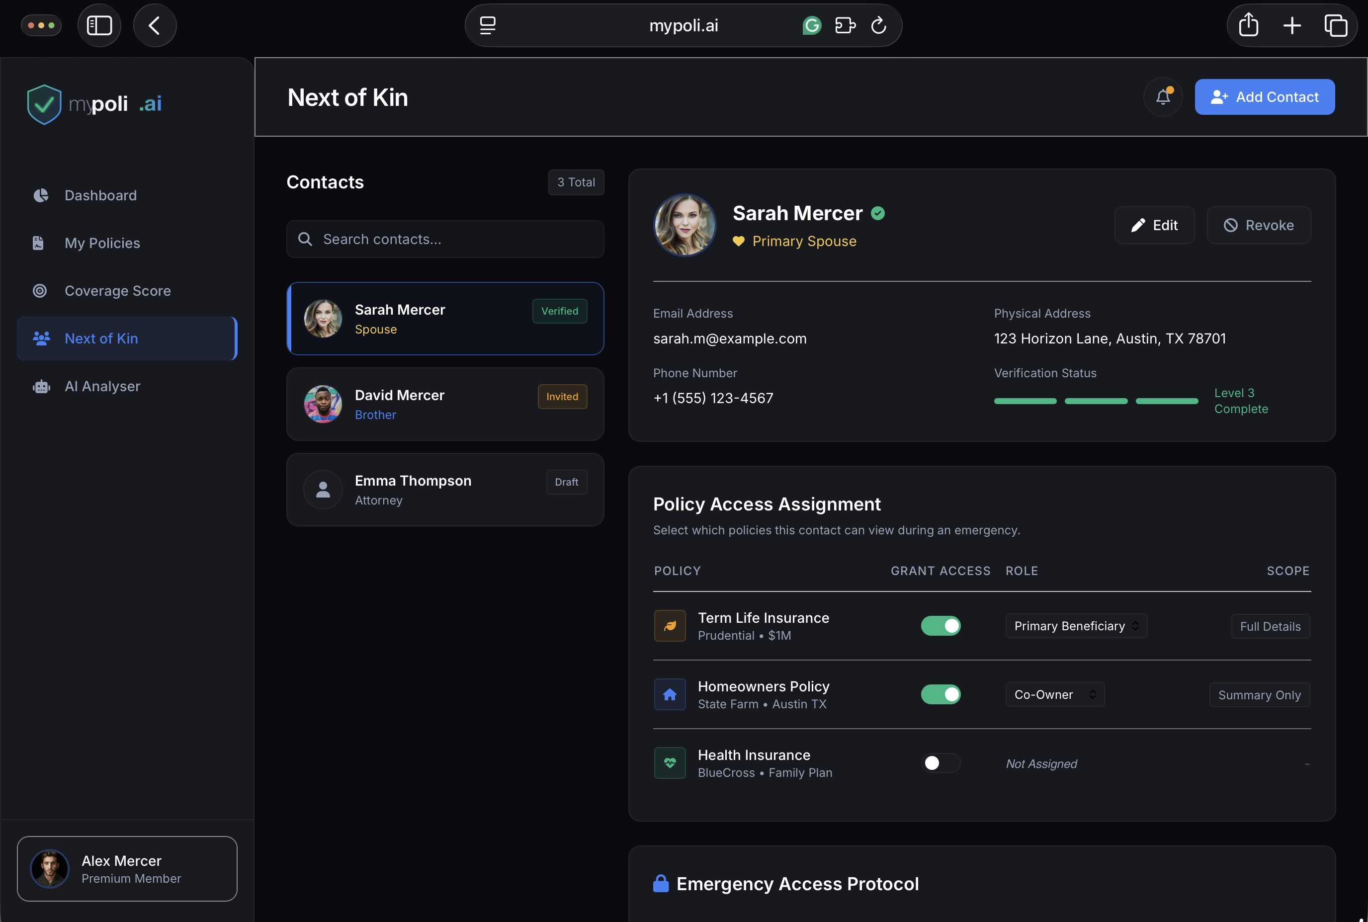
LAYER 02 — INTELLIGENCE
Know what you're actually covered for.
Plain English analysis
Every exclusion, limit and condition explained simply
Coverage Score 0–100
Across Life, Health, Property, Cyber, Liability, Income
Gap identification
Specific to your property, location and family profile
Underinsurance calculator
Are you covered for what your assets are actually worth?
Market benchmarking
Are you overpaying vs comparable policies right now?
This is not a chatbot.
This is a persistent intelligence layer
built on your actual policies.
Replace with screenshot

Slide 6
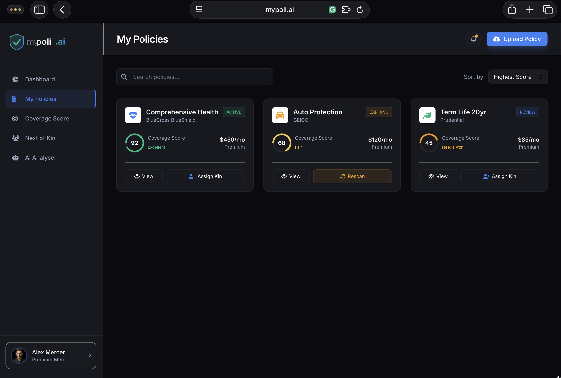
LAYER 03 — ACTION
Information without action
is just noise.
Switch to better cover
Live market comparison → one-click switching
Renewal management
Alerts before renewal · pre-filled forms · negotiation tips
Claims guidance
Step-by-step support when you actually need to claim
Next of Kin vault
Family access in an emergency — without needing to call anyone
Proactive recommendations
Flagged when your life changes: new property, new child, new job
Replace with screenshot

Slide 7
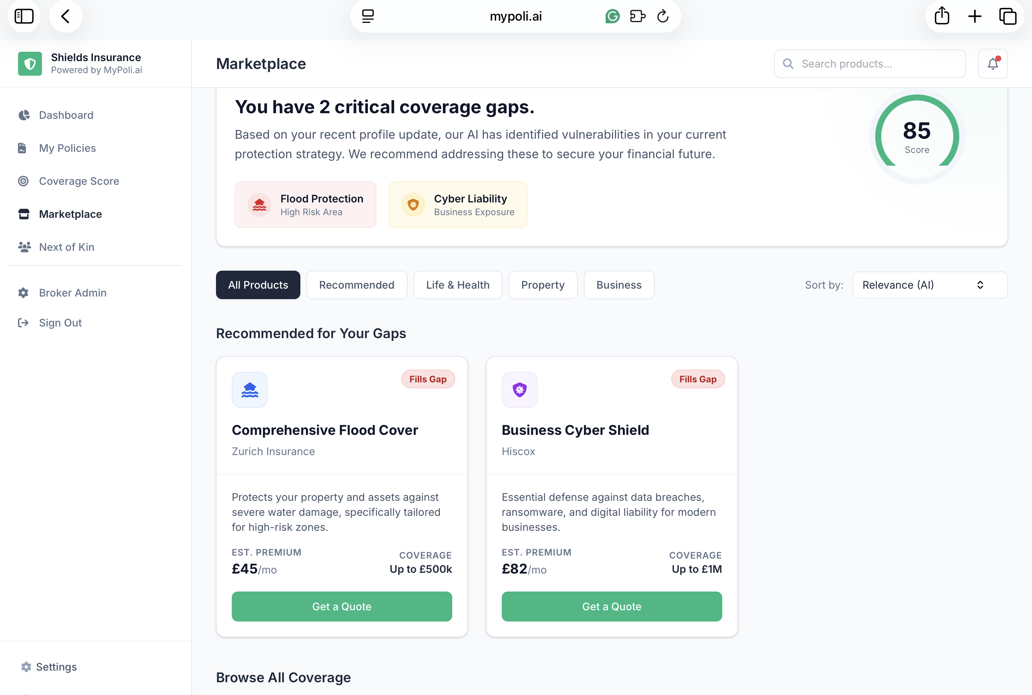
LAYER 04 — ECOSYSTEM
The B2B layer that
makes this fundable.
White-Label Broker Portal
Fully branded platform per broker · custom domain · admin panel
Marketplace Engine
Coverage gap → product recommendation → quote in one flow
Enterprise API
€500/mo · carriers and aggregators embed MyPoli intelligence
Broker Analytics
Client coverage scores · gap trends · renewal pipeline visibility
Investors prefer B2B. This is the B2B layer.
Consumer growth funds the ecosystem. The ecosystem funds the raise.
Replace with screenshot

Slide 8
03 — COMPETITIVE POSITION
"Why not just paste your policy into ChatGPT?"
The question every investor will ask. Here's the answer.
Generic AI (ChatGPT / Claude)
MyPoli.ai
✗
Reads one document at a time
✓
Holds your entire insurance profile
✗
No memory between sessions (Free Version)
✓
Persistent — builds over time
✗
No market price comparison
✓
Live market benchmarking and pricing
✗
No life profile or gap analysis
✓
Personalised to your property and family
✗
No switching or claims action
✓
One-click switching and claims guidance
✗
No family / next of kin access
✓
Next of kin vault with emergency access
✗
No broker or insurer integration
✓
White-label API for brokers and carriers

Slide 9
04 — MARKET OPPORTUNITY
A massive market with
a clarity gap.
€1.4T
40K+
€12B
2/3
Global insurance
brokerage market
Independent brokers
in Ireland & UK
InsurTech market
by 2027
Of all InsurTech VC
went to AI in 2025
TAM · SAM · SOM
TAM €1.4T — Global insurance brokerage market
SAM €42B — Europe — AI-addressable broker + consumer segment
SOM €850M — UK & Ireland 5-year addressable market

Slide 10

05 — USER STORIES
Three people who need this today.
Sarah, 38
James, 52
Maria, 71
Homeowner & parent
Independent broker
Retired, lives alone
Has home, life, car and health insurance — never read any of them. After a flood scare she doesn't know if she's covered. Uploads all four policies. Within 60 seconds her coverage score is 62 — Flood is red.
Manages 400 clients. Renewal season is brutal — no visibility into who has dangerous gaps until they call with a claim. White-labels MyPoli.ai. Now sees every gap across his entire book from one admin dashboard.
Has several policies her late husband set up. No idea what they cover. Her daughter is abroad. Daughter logs in via next of kin access — sees all policies, scores and key contacts without calling anyone.
→ Adds flood cover. Sets up next of kin access for her husband.
→ Identifies 68 clients with cyber gaps. Sends a targeted offer in one click.
→ Finds an unclaimed life policy worth €45,000.

Slide 11
06 — REVENUE MODEL
Two streams. One platform. Built to scale.
Consumer — Freemium
B2B — White-Label & API
Free
€25,000/year
3 AI analyses, 5-page upload limit
Per broker · white-label platform licence
€9.99/month
€2,500
Unlimited · all policies · full chat
One-off onboarding and config fee
€79/year
Revenue share
Annual — 34% saving
On marketplace policy referrals
€14.99/month
€500/month
Family plan · up to 5 members
Enterprise API · carriers + aggregators
Included
Custom
Next of Kin vault in all paid plans
Large broker co-branding tier
5 broker partners × €25K = €125K ARR · 500 consumers × €9.99/mo = €60K ARR · Year 1 target: €185K ARR

Slide 12
07 — BUILD PLAN
From concept to production — 18 weeks.
Phase 01 · Weeks 1–6
Phase 02 · Weeks 7–14
Phase 03 · Weeks 15–18
Core Platform
White-Label
Vault + Polish
€29,000
€41,000
€24,000
Auth + database (Supabase)
Multi-tenant architecture
Next of Kin access logic
PDF parsing + OCR
Broker admin portal
Identity verification (Onfido)
Anthropic AI API (production)
Marketplace + gap matching
Mobile responsive QA
Coverage Score engine
Custom domain per broker
Security audit (OWASP)
Stripe payments + freemium
Email notifications
Production launch
€94,000
+€14,100
€108,100
18 weeks
Total build
Contingency 15%
Total to v1.0
To production

Slide 13
08 — USE OF FUNDS
€350,000 Pre-Seed · SAFE Note
Use of Funds | Amount | % | Covers
Platform Build (Phases 1–3 + contingency) | €108,100 | 31% | Full v1.0 in 18 weeks
Sales & Broker Development | €100,000 | 29% | First 3–5 broker pilots
Marketing & Consumer Acquisition | €70,000 | 20% | Paid + organic growth
Legal, Compliance & IP | €30,000 | 9% | Entity, GDPR, contracts
Operations & Runway | €41,900 | 11% | 18 months runway
Total | €350,000 | 100% | 18 months

Slide 14
09 — TRACTION & MILESTONES
Where we are. Where we're going.
✓ Done
→ Next 90 Days
Full consumer platform built and deployed (mypoli.ai)
First broker LOI signed — design partner confirmed
White-label broker platform — 10 pages, fully functional demo
Irish Ltd company registered
Investor deck, NDA, build plan and brand assets complete
Pre-seed raise initiated — €350K SAFE
Access gate with per-code tracking live on Vercel
OH.io partnership conversation concluded
5 Irish broker design partner targets identified and outreached
Fractional CTO engaged — build begins
Meetings arranged with WHYRE advisory and OH.io
First 50 consumer waitlist signups
Domain secured · mypoli.ai
Production build starts

Slide 15
The Ask
€350,000
Pre-Seed · SAFE Note
€108K
€100K
€70K
€72K
Build the platform
First broker partners
Marketing & growth
Legal, ops & runway
mypoli.ai
hello@mypoli.ai · mypoli.ai · Demo access code: investor

